Slide 1
AI RECRUITER

Slide 2
INTRODUCTION
AI recruiting is often described as the largest tech-induced transformation that ever hit the talent acquisition industry, and it seems that the hype is growing every week
AI for recruiting is the application of artificial intelligence, such as the learning or problem-solving that a computer can do, to the recruitment function. This new technology is designed to streamline or automate some part of the recruiting workflow, especially repetitive, high-volume tasks

Slide 3
Existing Problem--
Now a days we have some of the techniques for recruiting the candidates but it is not sufficient for the present day situation. Present recruiting process doesn’t allow more candidates at a time.
The typical customer care Chabot can answer simple questions, such as locations and hours, directions, and may be even making appointments. When a question falls outside of the scope of the pre-determined question set, the option is typically to tell the customer the question is not valid or offer to speak to a real person.

Slide 4
Proposed solution
In this project, we will provide another option. If the candidate entered all details in the webpage, the Chabot will use the webhook feature of Watson Assistant to pass the question onto our Watson Discovery Service, which has been pre-loaded with the device’s database manual. So now, instead of “Would you like to speak to a company representative?” we can return relevant sections of the webpage to help the candidate recruiting problems.

Slide 5
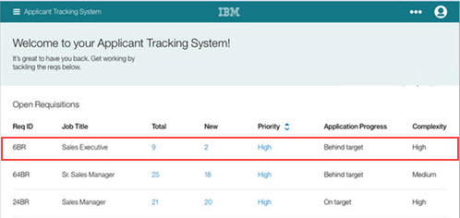
Application Tracking System

Slide 6
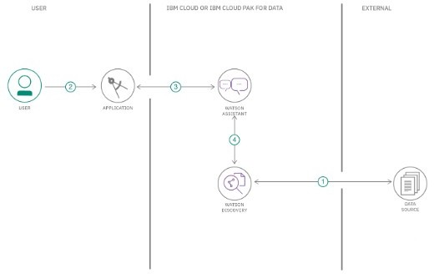
Block diagram

Slide 7
Software Required :
IBM Cloud,
Node-RED,
Db2,
Watson assistant,
Cloudant

Slide 8
Experimental Investigations
Step – 1 : Create IBM CloudServices
Create the following services :
Watson Assistant
Node-Red
Cloudant
Db2

Slide 9
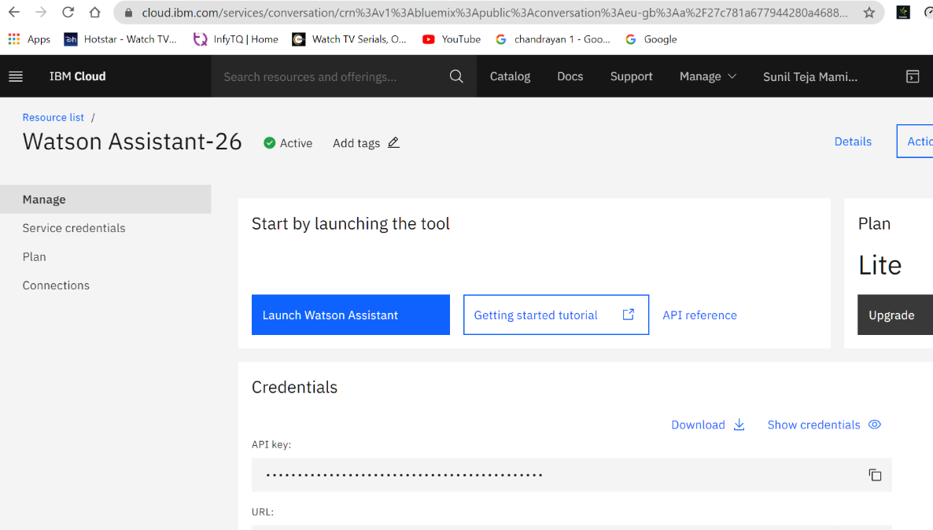
Step – 2: Configure Watson Assistant

Slide 10
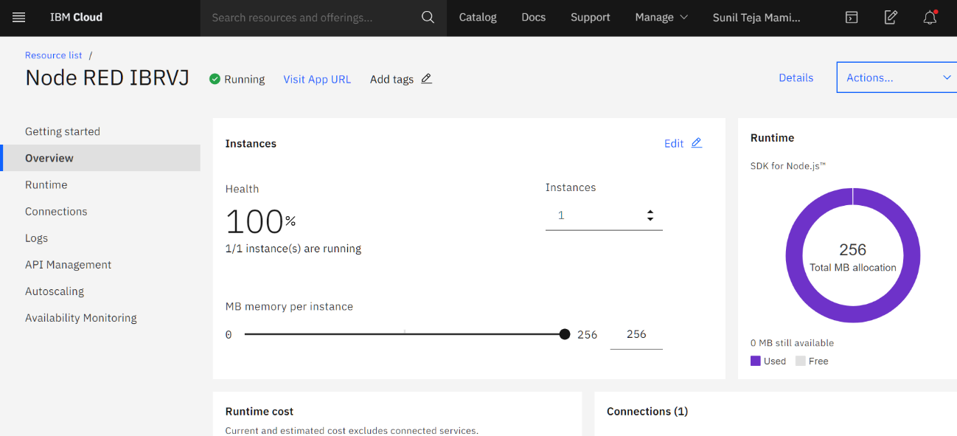
Step – 3 : Create the Node-REDflow

Slide 11
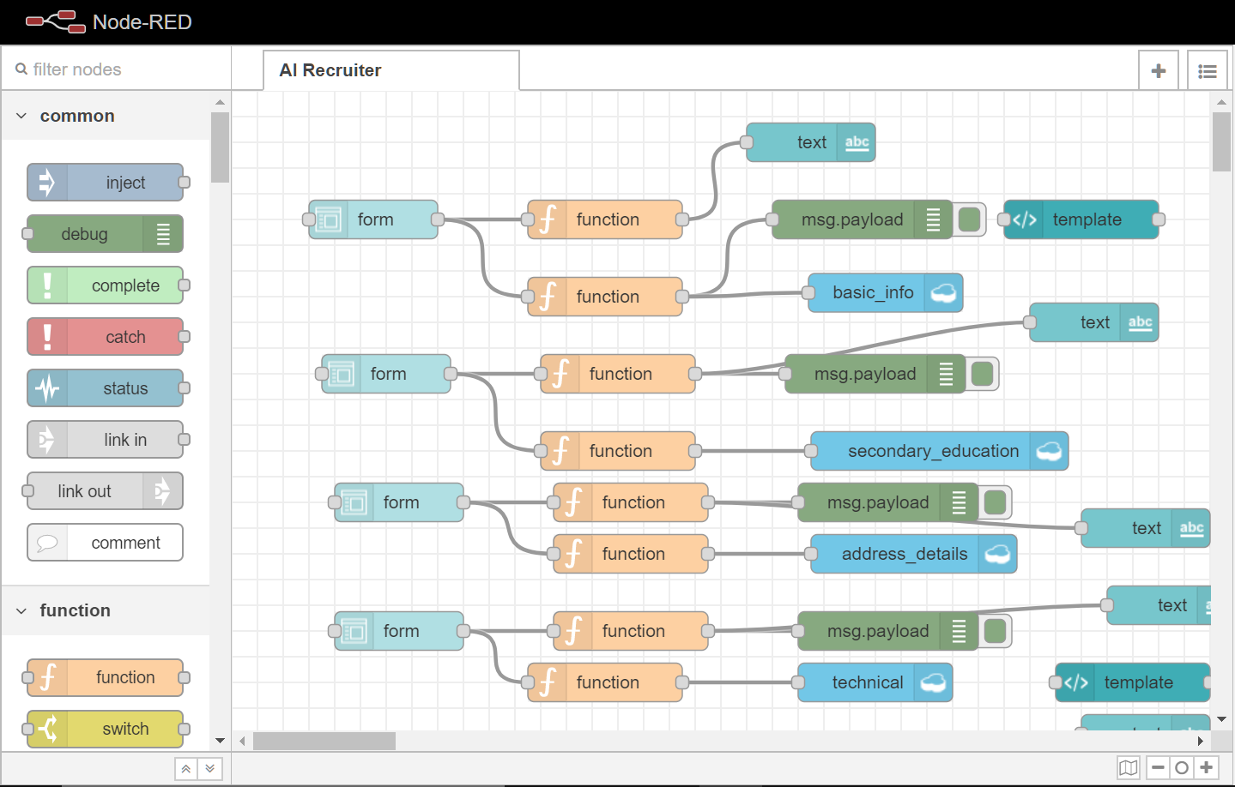

Slide 12
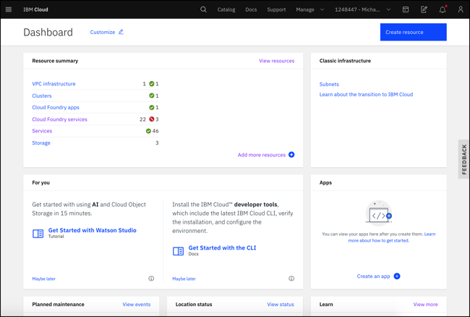
Step – 4 : Create the Cloudant:

Slide 13
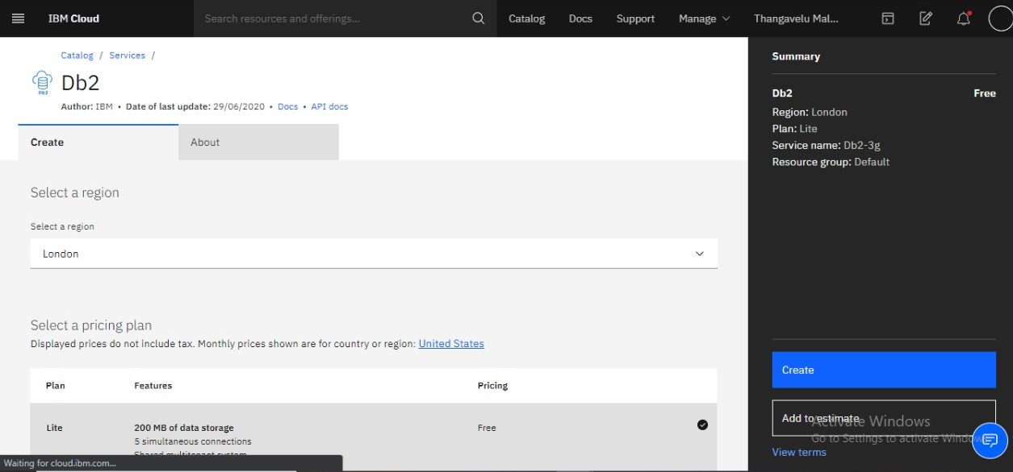
Step – 5 : Create the Db2:

Slide 14
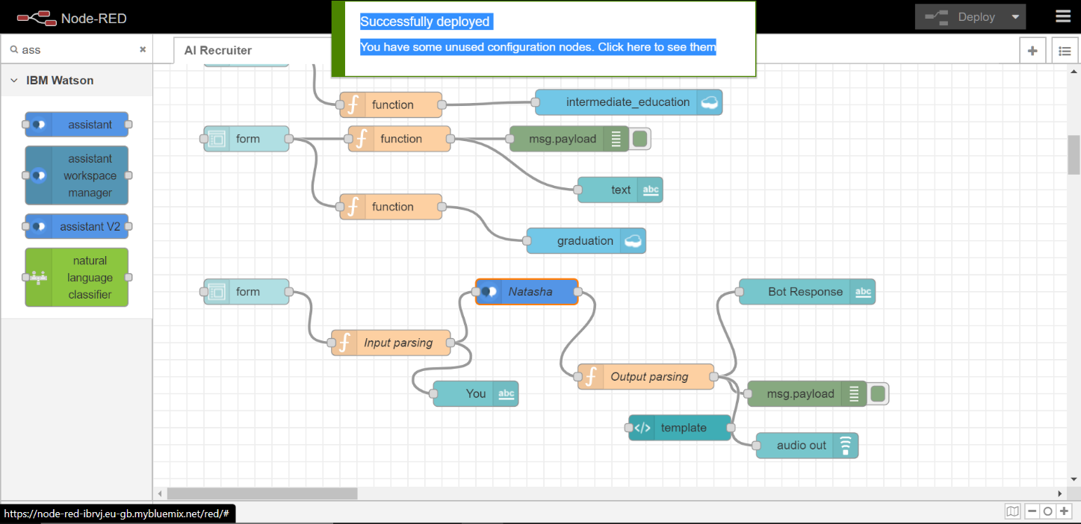
RESULT

Slide 15
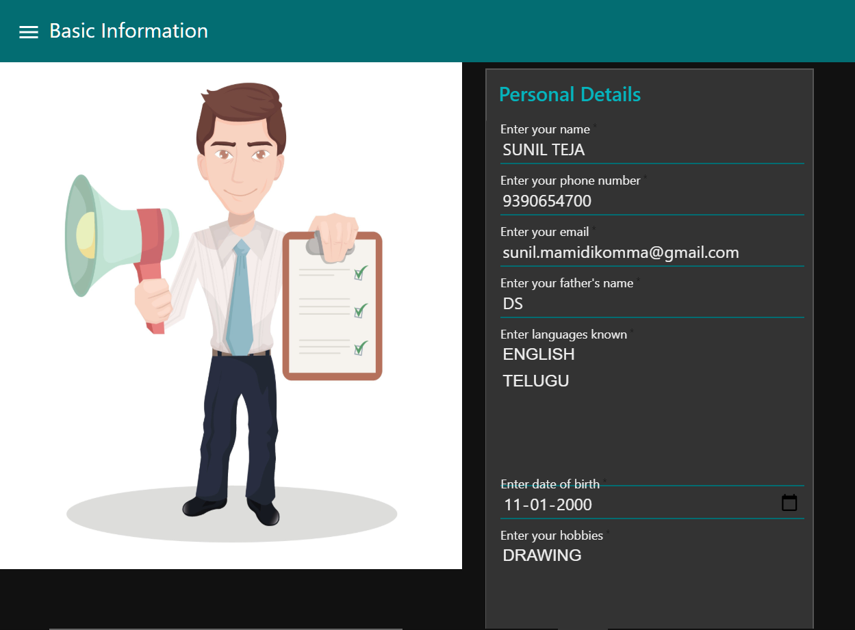

Slide 16
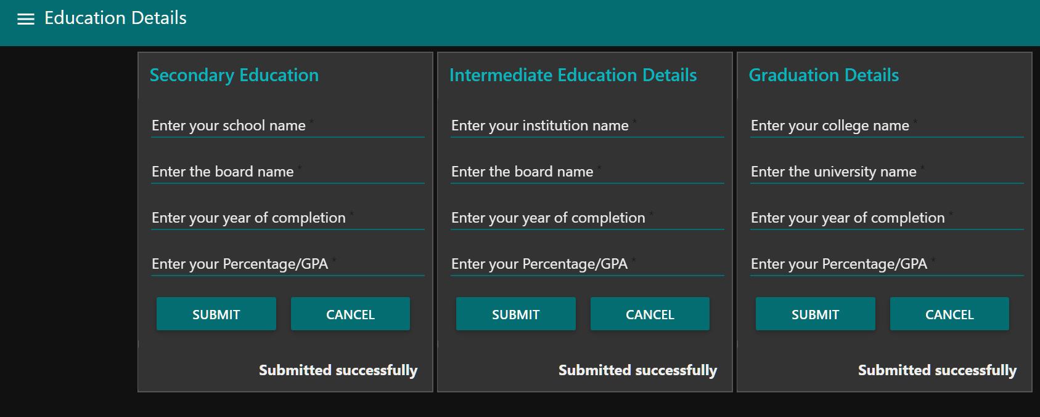
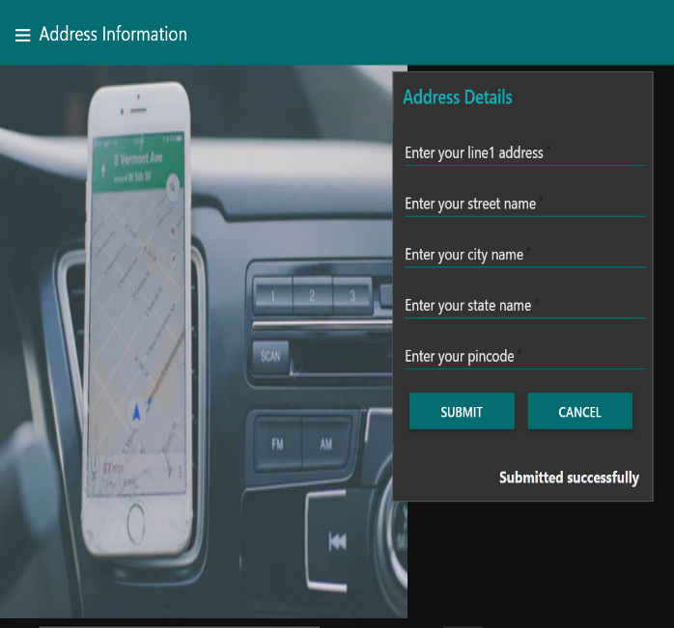

Slide 17
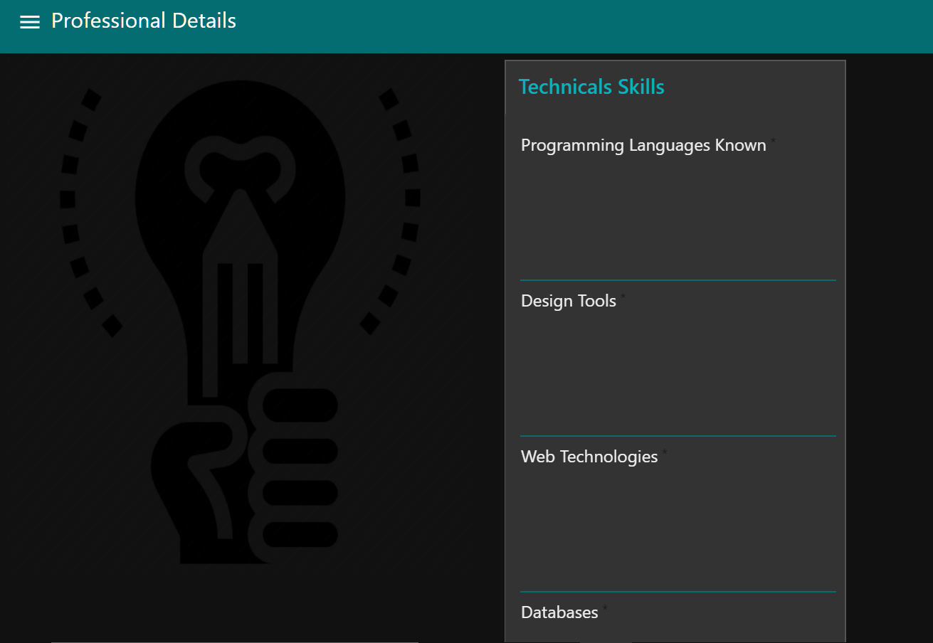
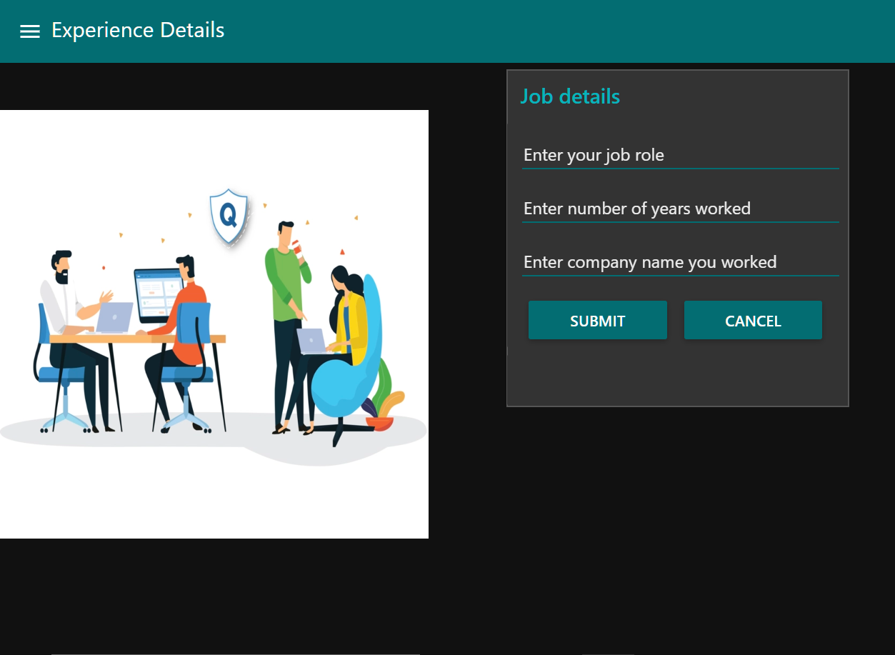

Slide 18
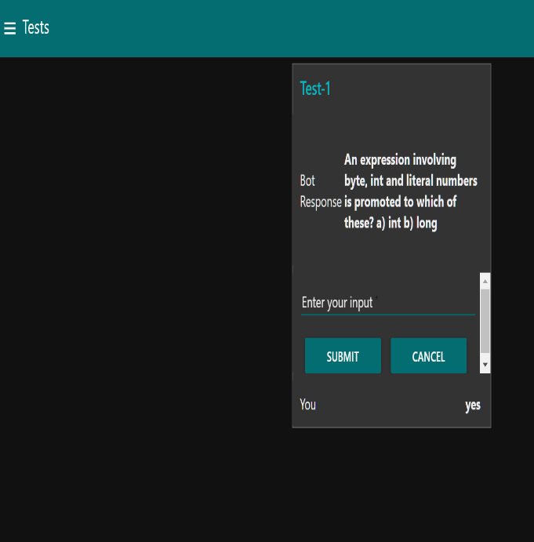
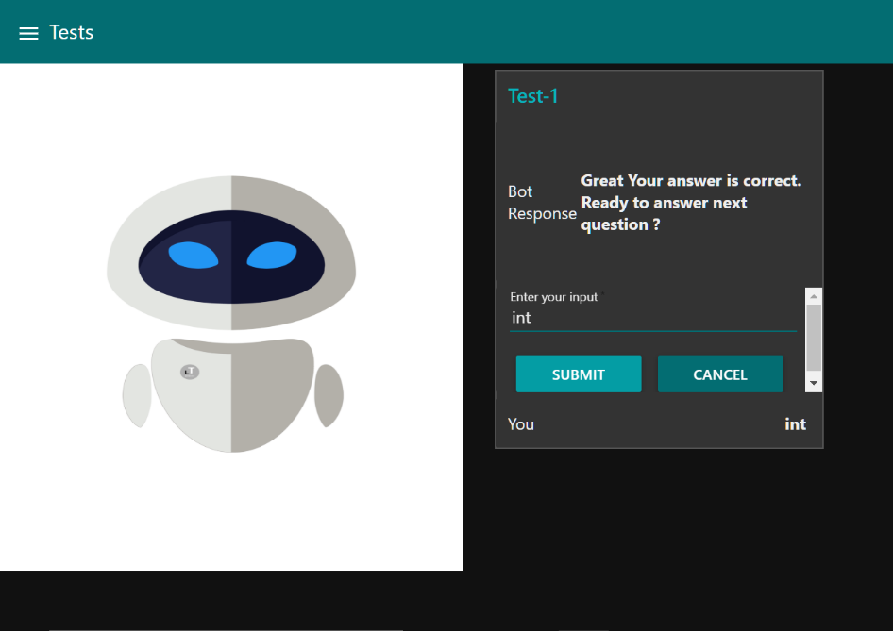

Slide 19
Advantages
1. Improved Quality of Candidates
2. Automate Tedious Manual Tasks 3. Better Experience for Candidates 4. An optimized Recruitment Process 5. Cost Effective Hiring 6. Reduced Time to Hire 7. No more ‘talent waste’

Slide 20
Future scope
Artificial intelligence in recruitment can significantly improve candidate engagement through improved communication between candidates and employers. AI can help with sourcing in a number of ways. For example:
Parse and search LinkedIn, Facebook and many other platforms to find qualified candidates with the right background.Sending personalized outreach emails.Easier rank matching candidates (hard with boolean search).Predict the likelihood of a candidate to make a move.The current crisis is horrible for everyone. People are dying, economies are shutting down and employees are being laid off their jobs. But crisis is also the mother of all innovation.

Slide 21
Conclusion
Digital tools have been a big help to keep work going in this unprecedented, global crisis. And in many ways there’s reason to believe that this will speed up technology adoption. As people are forced into using tech in their daily work-life, we believe this will be an eye-opening event with a profound impact on work-life post Corona. Remote working is one thing that likely will continue to see a much higher use even after things cool down. People realize that remote meetings work pretty well.
To avoid face to face communication during pandemic situations
To get high accuracy in finding suitable candidate
To overcome situation like living in a remote location
To manage recruitment time and cost

Slide 22
THANK YOU

